Slide 1
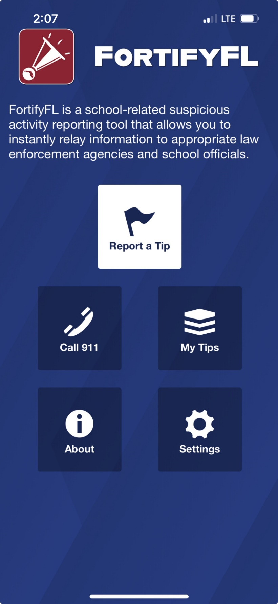
Anonymous Reporting App
Notes:
Suggested talking points:
The safety of our students is very important.
FortifyFL is a website and an app where anyone can report safety concerns.

Slide 2
You Should Know:
There is an anonymous reporting app that allows you to instantly send information about suspicious activity.
Notes:
Anyone can choose to remain anonymous using the FortifyFL website or app.

Slide 3
See Something, Say Something
With FortifyFL, you can submit tips about potential crimes or threats which are sent directly to law enforcement and designated school personnel.
Notes:
See Something, Say Something, Do Something.
Users can instantly send information about suspicious activity, crime, serious threats, etc., to local law enforcement and school officials.

Slide 4
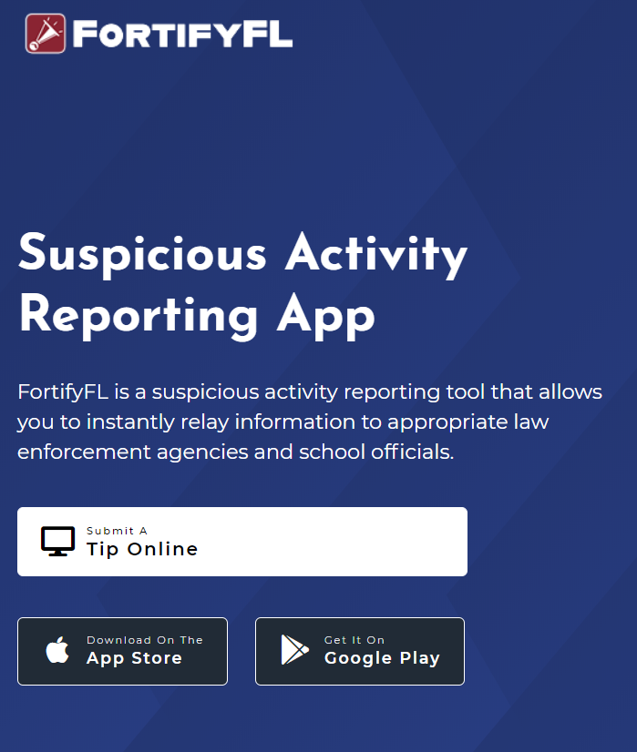
How do I submit a tip?
You can submit a tip from any computer at: GetFortifyFL.com

Slide 5
How do I submit a tip?
You can also submit a tip using your phone. Download the FortifyFL App on your phone or tablet.

Slide 6
How do I submit a tip?
Tips must have actionable information.
This means including WHO did WHAT, WHERE it happened and WHEN.
More tip details improve the chances that a situation can be resolved.

Slide 7
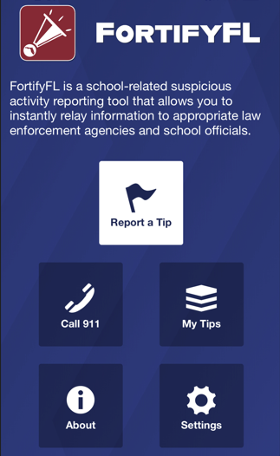
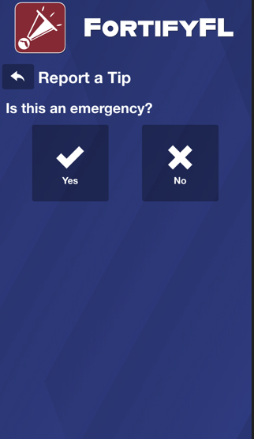
How do I submit a tip in the app?
Click “Report a Tip” and indicate if it is an emergency

Slide 8
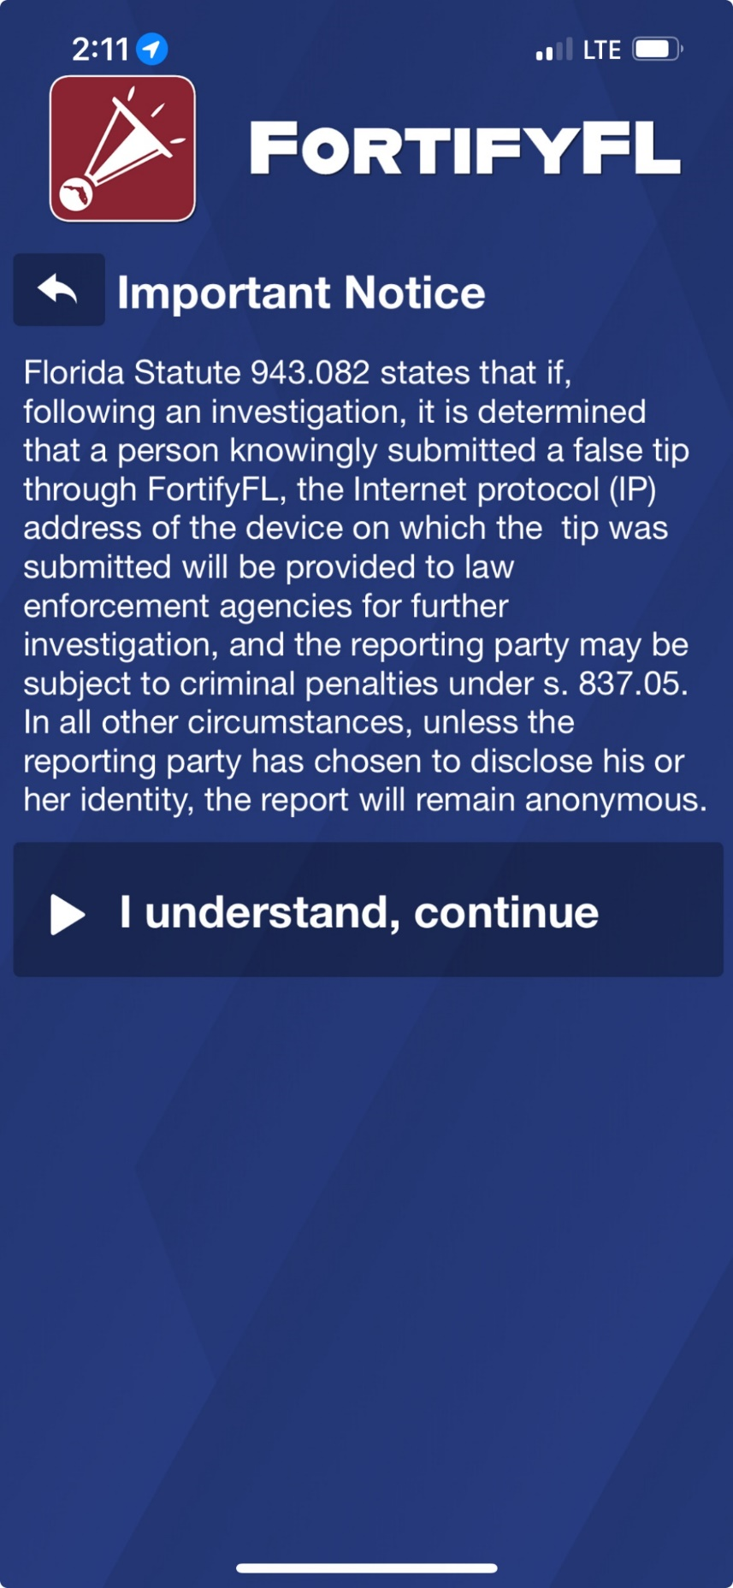
How do I submit a tip?
Important Notice:
Per Florida law if someone knowingly submitted a false tip through FortifyFL, device information will be provided to law enforcement, and the individual could be subject to criminal penalties.
Notes:
It is important to understand that knowingly submitting a false tip through FortifyFL is a serious offense (a 3rd degree felony).

Slide 9
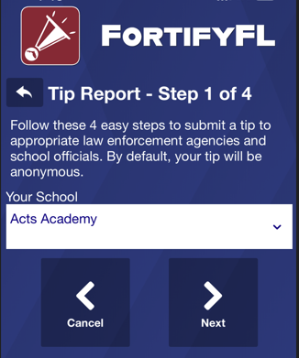
How do I submit a tip?
Step 1:
Select Your School

Slide 10
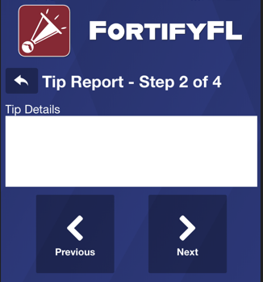
How do I submit a tip?
Step 2:
Provide Your Tip
Be sure to give enough information to get the right kind of help.
A student on my bus (#302) had a gun he was showing off. I don’t know his name but he’s got red hair and wearing a light gray hoodie with a triangle logo on it.
Notes:
The tip reads, “A student on my bus (#302) had a gun he was showing off. I don’t know his name but he’s got red hair and wearing a light gray hoodie with a triangle logo on it.”
This tip includes:
WHO - a student on bus 302 with red hair and wearing a light gray hoodie
WHAT - a gun
WHERE - on bus 302
This tip has good information; it’s missing the WHEN – did this happen this morning? Last week?
Tips are useful when they include actionable information.
Please provide enough detail.
Some examples of tips that are not as useful – taken from FortifyFL:
Someone posted a pic on snap of a gun saying he will shoot up the school on may 20th im scared
Student assaulted a teacher by kicking and punching her.
There's a girl in the hallway taking about framing a boy
there was a threat i am scared
Mutual friend was shown a gun in the classroom
This one boy keeps following me to my classes and tried to give me a hug and kiss
Individual is posting disturbing content on his social media, threatening to “kill the ***s”, posting about explosives etc
Vague information is not helpful – if someone is in crisis, who? If there is unsafe activity on campus – where?

Slide 11
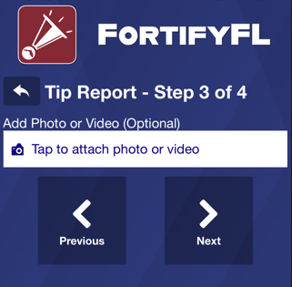
How do I submit a tip?
Step 3: Attach an Optional Photo or Video

Slide 12
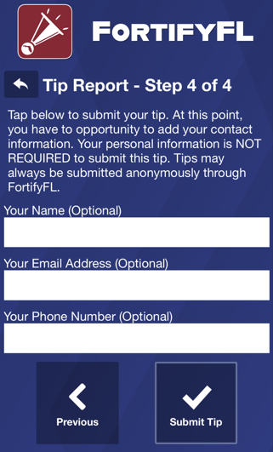
How do I submit a tip?
Step 4:
Provide Optional Information and Submit Your Tip
Notes:
If there is a need to remain anonymous, then skip this section. If you are worried that others will know about your tip, just remember that your tip is not public. When you include your name and other information, you help those who may need to ask you questions.

Slide 13
Check out this video about FortifyFL
Notes:
On February 14, 2018, at Marjory Stoneman Douglas High School, 17 people were killed and another 17 were seriously injured in a school shooting.
The shooter exhibited many warning signs that he was on the path to violence. Following this tragic event, investigators learned that numerous people – mostly fellow students – knew about concerning statements and behaviors attributed to the shooter leading up to February 14, 2018.
FortifyFL is a tool that you can use if you know about someone wanting to hurt themselves or others.

Slide 14
Thank you for helping to keep our school and community safe
Notes:
Reporting through FortifyFL keeps us all safe.
Thank you.
For the teacher - If there are questions about why we have FortifyFL, here is the history:
FortifyFL was created and funded by the 2018 Florida Legislature as part of the Marjory Stoneman Douglas High School Public Safety Act. The application was named by students from Marjory Stoneman Douglas High School. The Office of Attorney General, Department of Education and Florida Department of Law Enforcement coordinated its development and roll-out.

